Slide 1
Fighting
West Nile Virus
15th August 2022
For: Chicago Department of Public Health
Cheong Hao Han, Phua Jia Qing, Choo Wende
Notes:
Good Morning everyWest Nile Virus (WNV) is a deadly virus that should not be taken lightly. Hence, Chicago Department of Public Health (CDPH) had established a comprehensive surveillance and control system by setting up traps for mosquitoes in order to test for the presence of WNV. CDPF have partnered with us for this research.

Slide 2
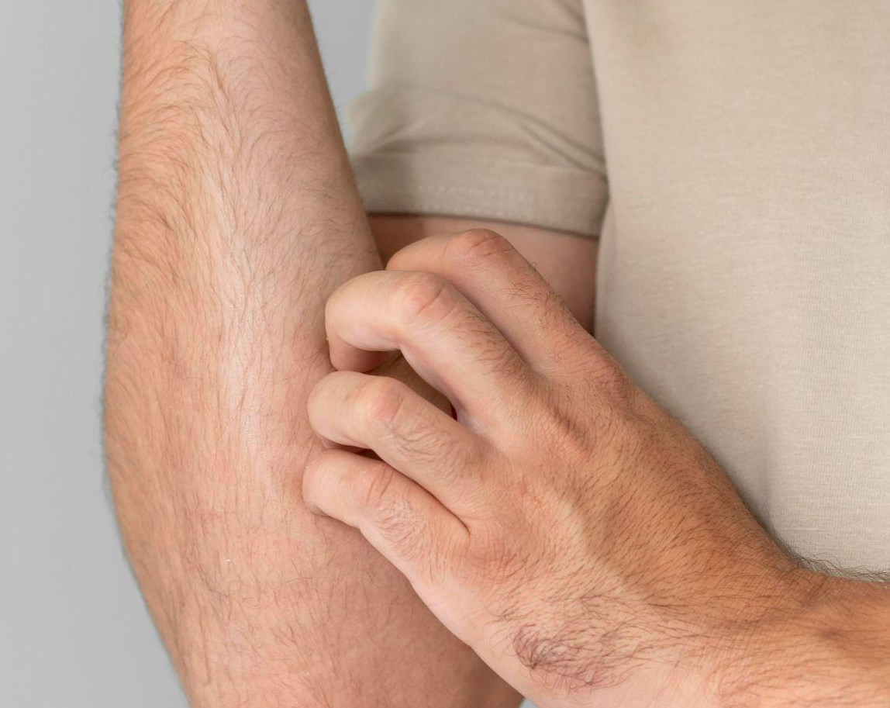
Content
15th August 2022
01
02
03
04
Background
Jia Qing
Data Analysis
Wende
Modelling
Hao Han
Recommendations
Jia Qing

Slide 3
01
Background and Outside Research
15th August 2022
Jia Qing

Slide 4
Predicting the presence of West Nile Virus (WNV)
15th August 2022
Notes:
West Nile Virus (WNV) is a deadly virus that should not be taken lightly. Hence, Chicago Department of Public Health (CDPH) had established a comprehensive surveillance and control system by setting up traps for mosquitoes in order to test for the presence of WNV. CDPF have partnered with us for this research.
The purpose of this research is to develop a model which predicts the presence of West Nile Virus (WNV) at various areas and time. The model aims to:
Predict areas with probable surge in number of WNV in advance.
Propose practical solutions to mitigate spread of WNV in the identified areas.
Using these information, we would be able to make inform decisions on where and when to deploy pesticides in Chicago. This way, we can maximise the effectiveness of pesticide while minimising monetary expenses.

Slide 5
Background
West Nile Virus
Peak Season
Culen Pipiens
Mosquito Activity
Life Cycle
Mosquito-borne disease
Optimal conditions
Species that carry WNV
Optimal conditions
4 life stages
Notes:
West Nile Virus
West Nile virus (WNV) is the leading cause of mosquito-borne disease in the continental United States. It is most commonly spread to people by the bite of an infected mosquito. Roughly 20% of people who are infected develop a fever and other symptoms which could lead to a more serious and fatal illness. Only certain species of mosquitoes can transmit WNV as shared by (source).
Culex Pipiens
The species - Culex Pipiens is considered the primary bridge of WNV to humans. A study done on Culex Pipiens on how is the lifespan affected by temperature. The results shows that lifespan increased when tempareture is decreased and vice versa. In terms of sex, female displayed a 1.2-1.4-fold longer longevity compared to the males. One can understand more from (source).
Life Cycle of a Mosquito
Mosquitoes have 4 life stages: egg, larve, pupa and adult. The entire life cycle (from an egg to an adult) takes approximately 8-10 days as shared by CDC (Centers for Disease Control and Prevention) (source). Under normal conditions, the average adult mosquito generally lives for approximately 2-3 weeks outdoors and lives for approximately 1 month indoors as shared by MMPC (source).

Slide 6
Peak Season
Rain Water
Precipitation
High Temperature
Notes:
West Nile Virus Peak Season and Optimal Conditions
Most cases of WNV happens during mosquito season, which starts in summer and continues through fall. This is due to the fact that mosquitoes breed in water. The 'Preventive Pest Control' blog shares some weather patterns that aid mosquitoes breeding. One can understand more from (source). Some factors are:
Rain Water
Flooding rains are ideal for mosquitoes to lay their egg.
When a water is stagnant, which is often the case with flood waters, there is a much greater chance that mosquitoes will lay eggs.
Precipitation
Heavy rainwater is linked to rainwater.
Higher Temperature
Hot weather actually shortens the incubation time of mosquito eggs.
Research also shows that number of mosquitoes carrying disease like West Nile is increased by warmer weather.

Slide 7
Mosquito Activity
Humidity
Wind
High humidity
No wind
Notes:
Mosquitoes Activity
Mosquitoes are most active at night and are likely to start to bite early in the evening. Hence, the best time to kill adult mosquitoes is to spray at dusk, when they are most active and looking for people to bite. Mosquitoes activity are affected by:
Humidity
High humidity conditions favor mosquito activity.
While low humidity suppresses activity and may even cause mortality.
Wind
Mosquitoes generally are not strong flyers therefore, mild, little or no wind would be good for mosquito activity.

Slide 8
02
Exploratory Data Analysis
August 20th
Wende
Notes:
Thanks Jia Qing! I will share on the Exploratory Data Analysis.

Slide 9
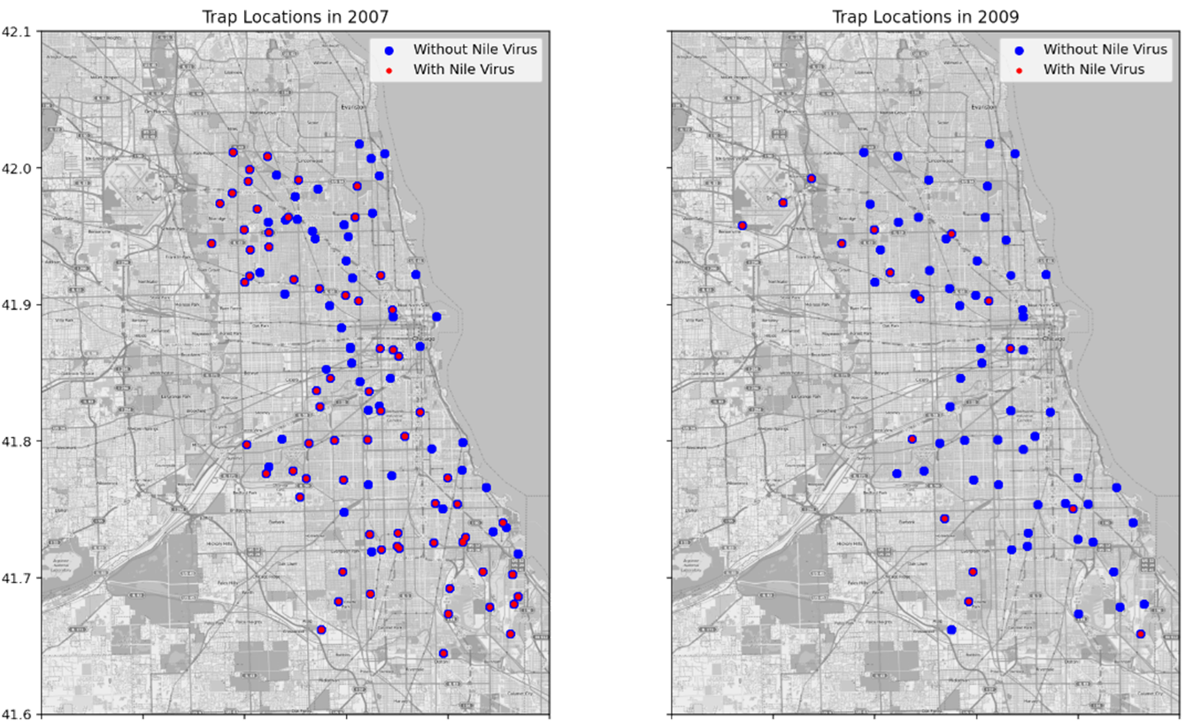
Reduced No of Traps with WNV (2007 & 2009)
Notes:
This is an overview of the traps and WNV present over the years. We can see that there is high count of WNV present in 2007 and there is a significant reduction in 2009.

Slide 10
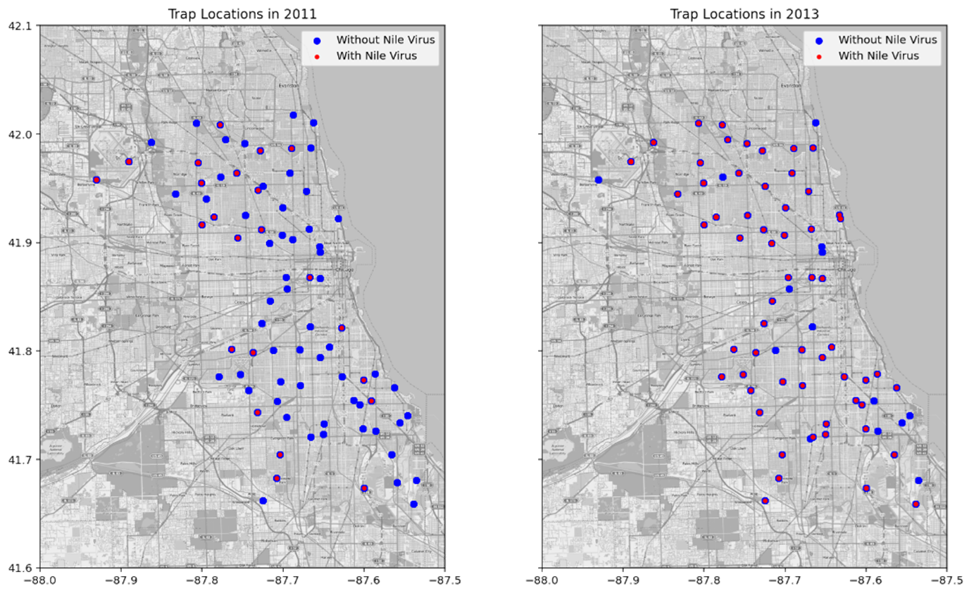
Proliferation of WNV in 2013 (2011 & 2013)
Notes:
In 2011, there is low count of WNV present, similar to 2009. Then there is a proliferation of WNV in 2013.

Slide 11
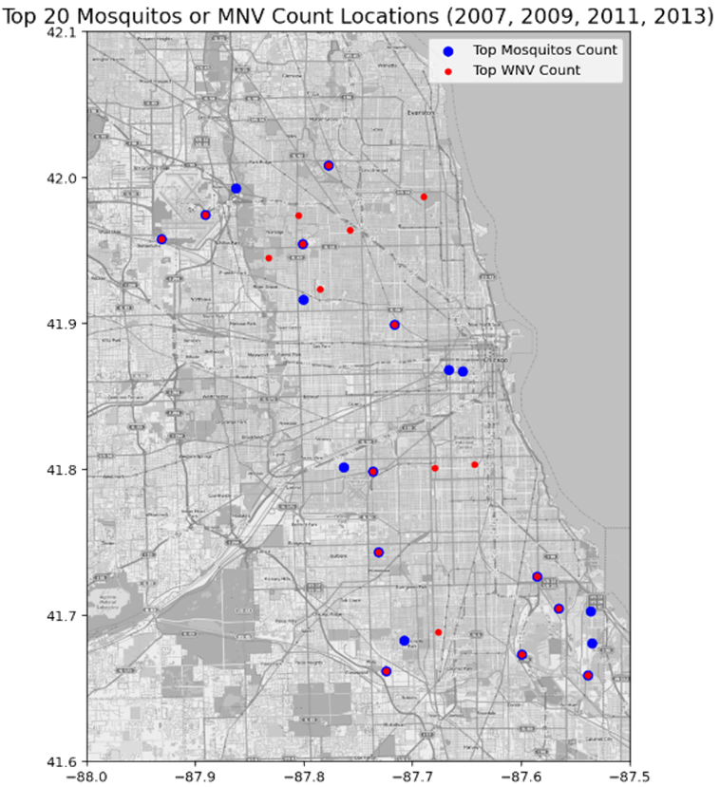
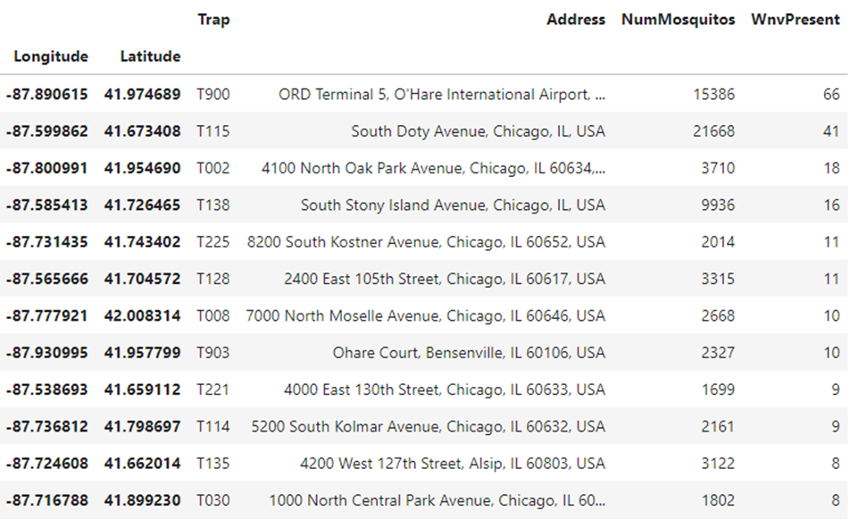
Top 12 NumMosquitos & WNV Present
Notes:
We have reviewed the top 20 traps with high number of mosquitos caught and high WNV present count. We found out that there are 12 traps that have top NumMosquito count and WMVPresent: 'T115', 'T900', 'T138', 'T002', 'T128', 'T135', 'T008', 'T903', 'T114', 'T225', 'T030', 'T221'.
These locations may be of interest to implement mitigations, such as spraying.

Slide 12
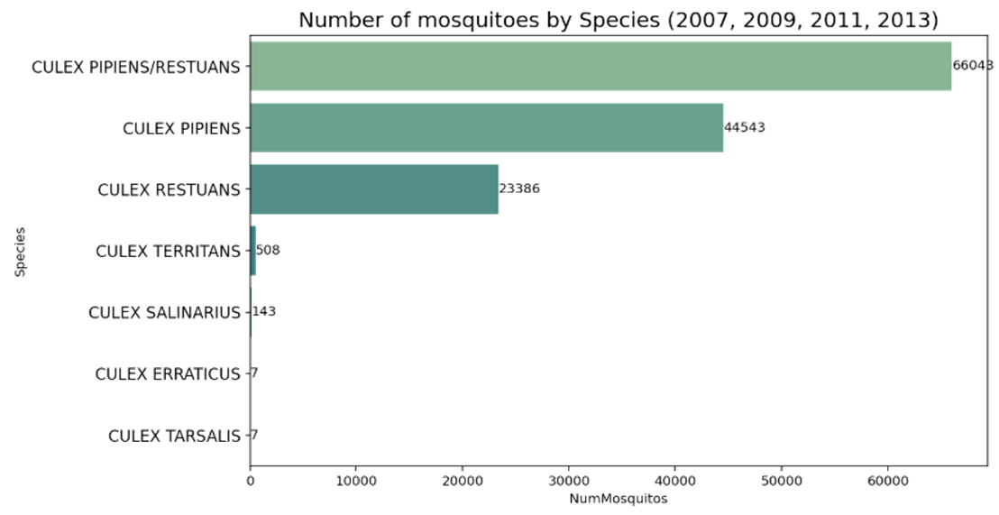
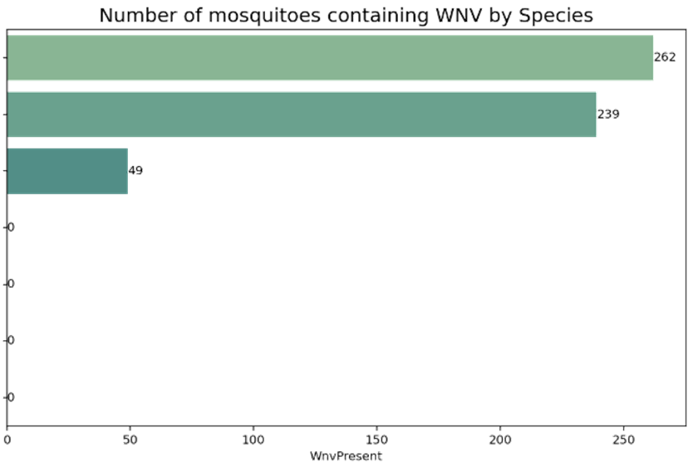
Pipiens & Restuans Carry WNV
Notes:
From the train data, Pipiens and Restuans are the most common species of mosquitos collected.
It is observed that only Pipiens or Restuans species mosquitos carry WNV
Pipiens species mosquitos are more likely to carry WNV than the other species. This is likely due to the high distribution of this specie collected.

Slide 13
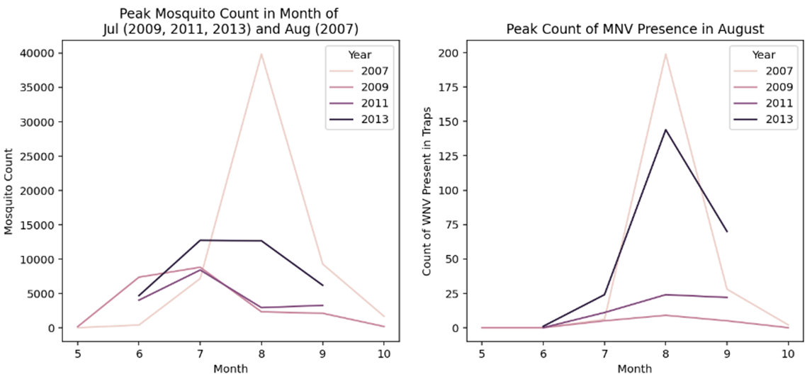
Mosquitos Data by Month
WNV is more prevalent in 2007 and 2013
Notes:
Let’s review at the mosquito data by month. Looking at the line plot of WMV Present count on the right, it is observed that WNV is more prevalent in 2007 and 2013.
This is consistent with the map overview findings discussed earlier.

Slide 14
Mosquitos Data by Month
WNV is more prevalent in 2007 and 2013
Higher proportion of WNV carrying mosquitos in 2013
Notes:
Looking at the mosquito count line plot on the left, the number of mosquitos caught in Aug 2013 is not as high as Aug 2007.
However, mosquitos caught in 2013 has comparable MNV Presence count as that for Aug 2007. This means that there is a higher proportion of WNV carrying mosquitos in 2013.

Slide 15
Mosquitos Data by Month
WNV is more prevalent in 2007 and 2013
Higher proportion of WNV carrying mosquitos in 2013
Highest occurrence of the WNV presence in month of August
Notes:
Lastly, it is observed that the occurrence of the WNV in mosquito samples have the highest rates occurring in August over the four years. The rates were highest in 2007, followed by 2013.

Slide 16
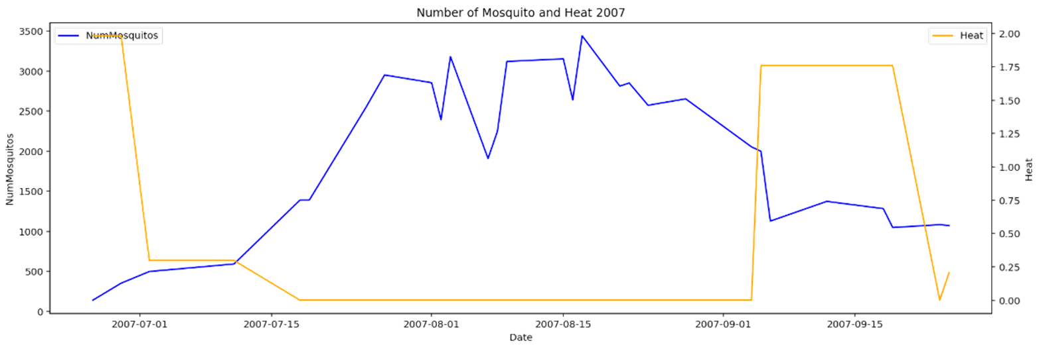
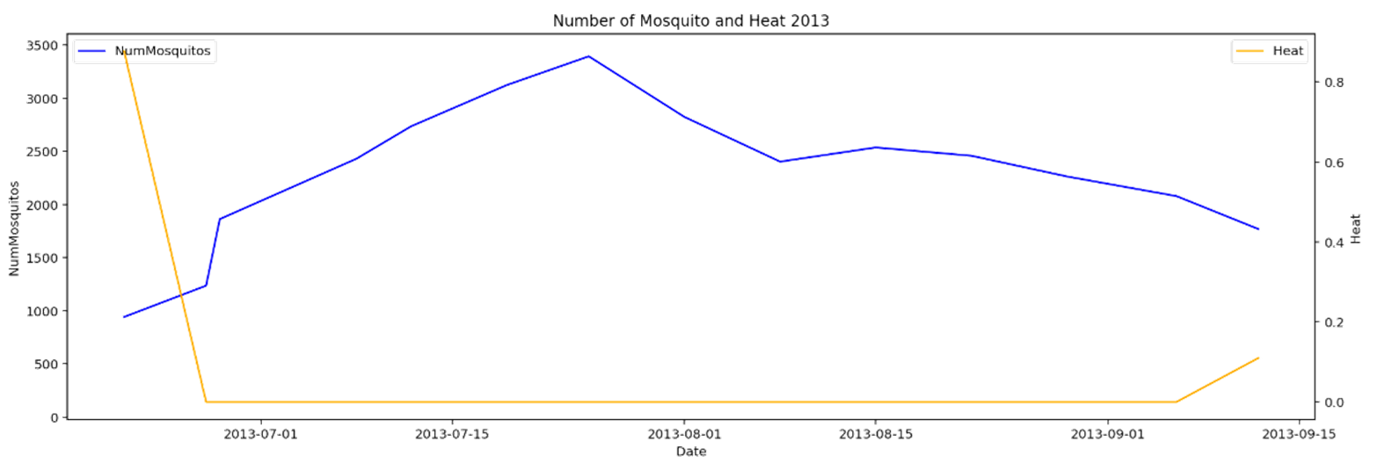
High Heat Level, Low Mos!
2007
2013
Num of mos increase around early Jul
Num of mos increase around early Jul
Notes:
We will now explore the weather data. I will share on some key findings from the data analysis
Heat level is a measure of how cold the temperature was on a given day or during a period of days.
From the heat level time series, we observed that heat level is inversely related to number of mosquitos. High heat level (colder the temperature) will result in lower mosquitos activities and lower mosquito count, which will reduce the number of WNV present.
It is postulated that the low heat level in early July stimulates the breeding of mosquitos.

Slide 17
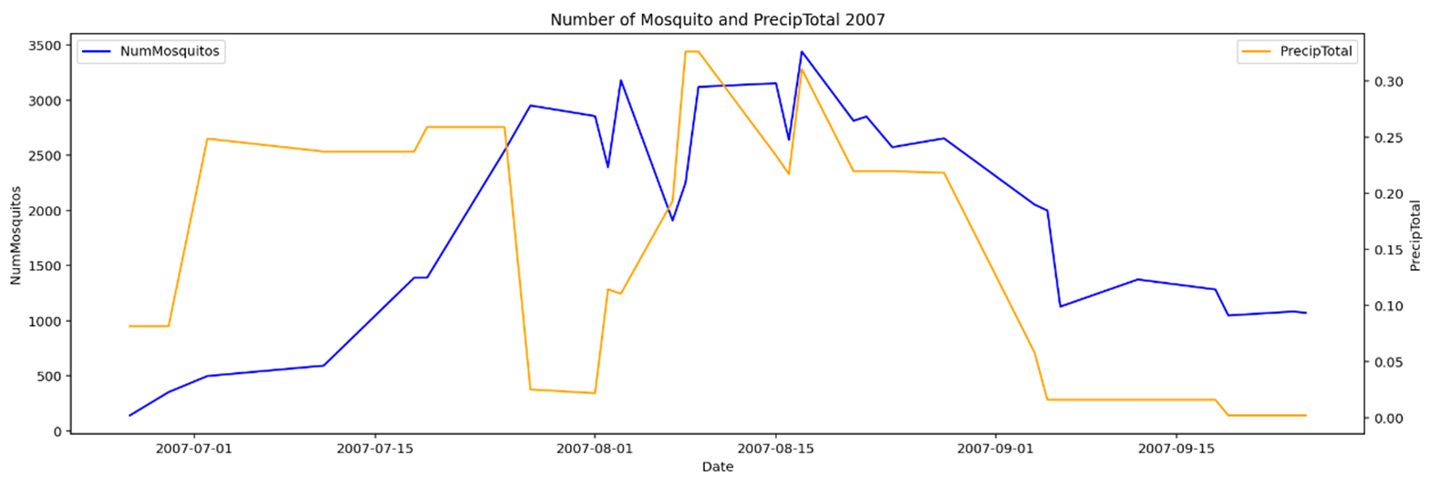
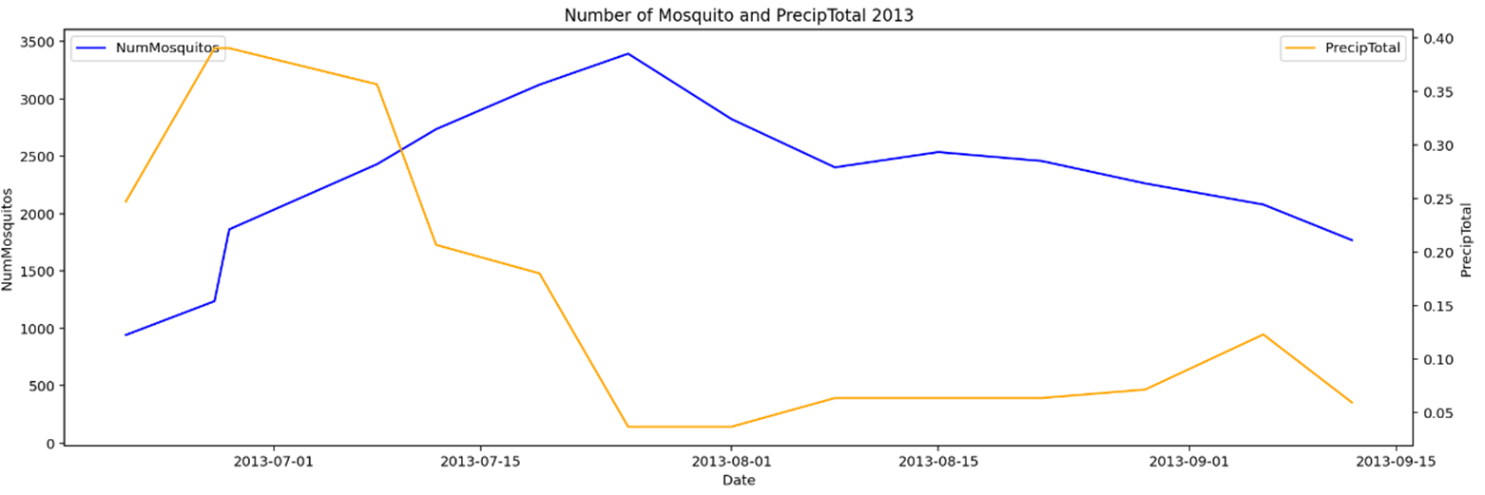
High Precipitate, High Mos!
2007
2013
Num of mos increase around early Jul
Num of mos increase around early Jul
Notes:
PrecipTotal has significant direct effect on number of mosquitos. High PrecipTotal will result in high mosquitos count, which may increase the number of WNV present.
In 2007 and 2013, the PrecipTotal is generally higher in early July. It is postulated that the high precipitation stimulated the breeding of WNV carrying mosquitos.
Hence, this explains the higher number of traps with WNV present.

Slide 18
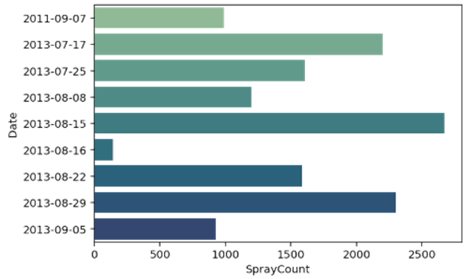
Spray conducted on 9 days in
2011 and 2013
August 20th
Spray dates mainly in month of Aug.
Notes:
Next, on the spray data. There is a total of 9 days of spraying in our record. 8 of the 9 days of spraying are done in 2013. I will share on the findings from 2011 spray and two days with the highest spray counts in Aug 2013..

Slide 19
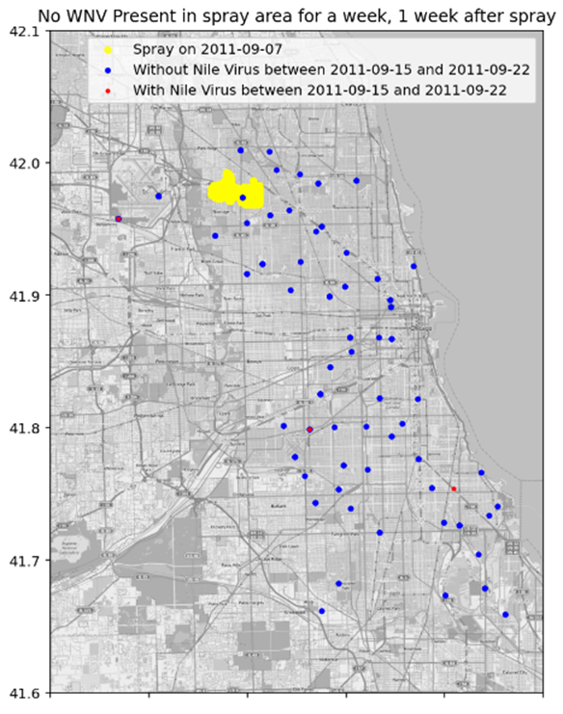
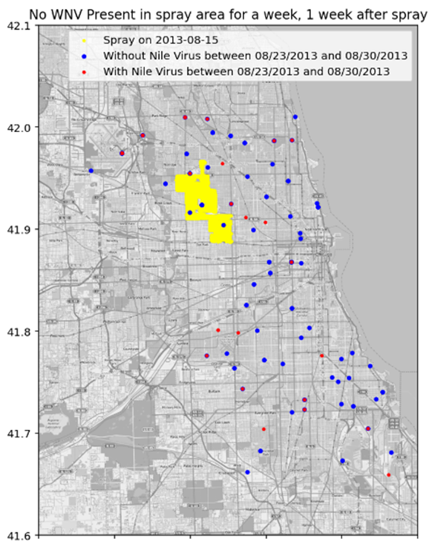
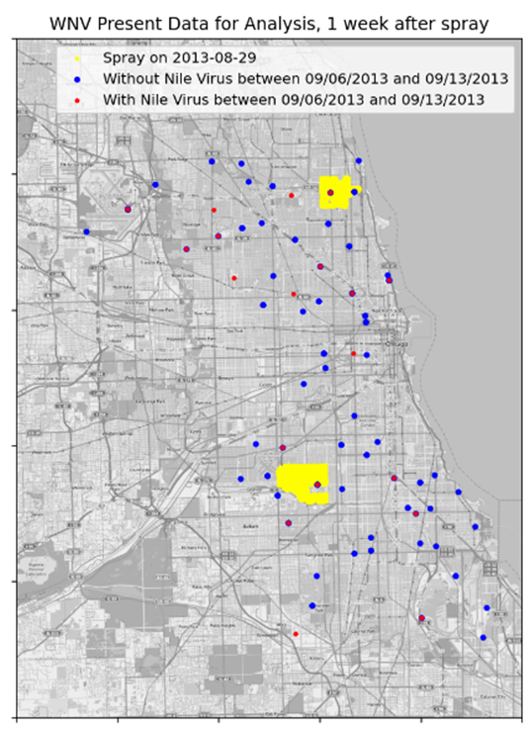
Limited Effects from Spraying
Notes:
As the cycle for mosquitos to grow from an egg into an adult takes about 8-10 days. We plotted the Num of mosquitos and WNV present 7 days after the spray for a duration of 1 week.
In general, no WNV was observed for 6 of the spray days. See the two examples on the left.
There is one spray date with WNV Present. See the map plot on the right.
We dont have data for two of the spray days and one of the spray day shows WNV Present.

Slide 20
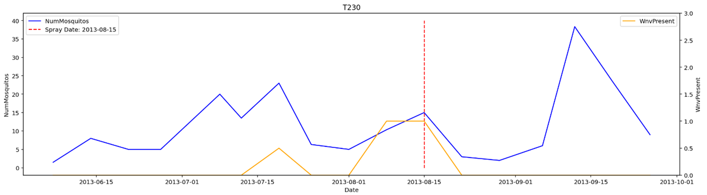
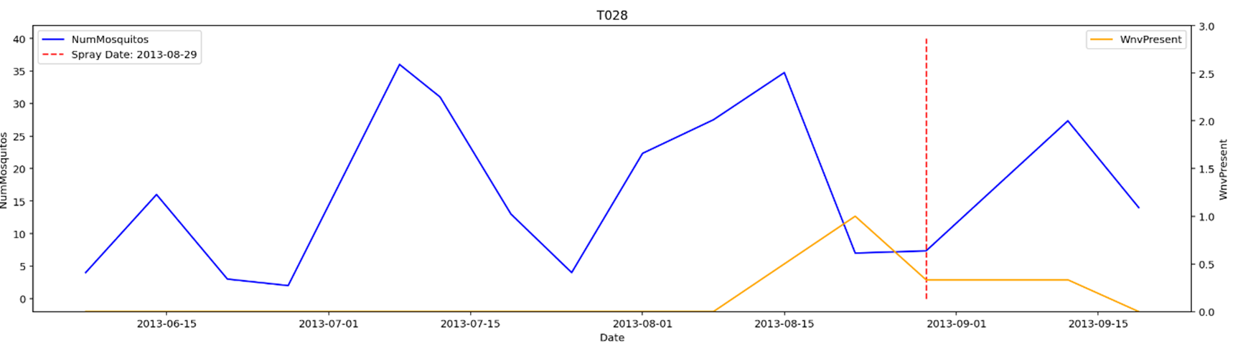
Limited Effects from Spraying
15/8/13
29/8/13
Notes:
Based on the mosquitos count and WNV presence plot of various traps, it is observed spraying is effective in reducing the number of mosquitos and directly decreases the number of WNV presence.
However, the effect of spraying lasts about two weeks, as it is observed that the number of mosquitos starts increasing thereafter.
From the mosquitos data analysis earlier, it was observed that the number of WNV carrying mosquitos starts increasing in early Jul. spraying conducted in end Jul and Aug seems to be reactive instead of pre-emptive.
Hence, if spraying needed to be done, it should be conducted in Jul when the PrecipTotal is high and heat level starts decreasing to prevent the breeding of mosquitos.
Next, I will hand over to Hao Han to share with us on the prediction model.

Slide 21
03
Modelling & Evaluation
15th August 2022
Hao Han

Slide 22
Models used
Logistic Regression
AdaBoost
K Nearest Neighbours
Gradient Boosting
Random Forest
Extra Trees

Slide 23
Modelling process
Function
Set Params
01
02
04
03
Refine
Compare
Created a function for modelling which includes scaling and smote
Set the hyper parameters for the respective models
Identify the useful and not useful features
Compare the model results

Slide 24

Model comparison
Model | Best score | Train score | Val score | Roc Auc
Logistic Regression | 0.821 | 0.832 | 0.798 | 0.732
KNN | 0.726 | 0.860 | 0.701 | 0.607
Random Forest | 0.836 | 0.865 | 0.810 | 0.727
AdaBoost | 0.833 | 0.850 | 0.814 | 0.726
Gradient Boosting | 0.834 | 0.889 | 0.822 | 0.676
Extra Trees | 0.830 | 0.847 | 0.809 | 0.726

Slide 25
Model comparison
Model | Best score | Train score | Val score | Roc Auc
Logistic Regression | 0.821 | 0.832 | 0.798 | 0.732
Random Forest | 0.836 | 0.865 | 0.810 | 0.727
Logistic Regression

Slide 26

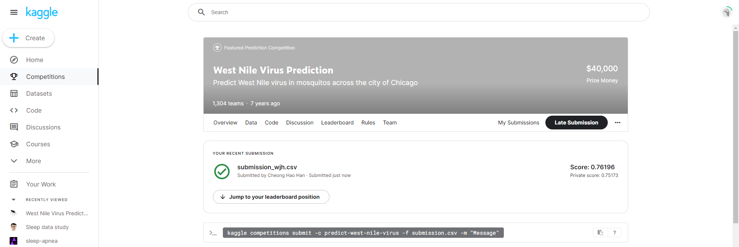
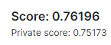
Predict WNV challenge
Kaggle
Use Logreg to predict WNV on the test set

Slide 27
Important features
Day
Duration
Season
Species
Trap Cluster
Mosquito are more active at night
Day, Week, Month, Year - trends affect activities
PIPIENS
RESTUANS
Low cluster
Identified by KMeans model

Slide 28
Important features
Moisture
Tempera
-ture
Wind Speed
Tavg, Heat
Higher temperature promotes activities
R-Humid, PrecipTotal, Dewpoint
High moisture promotes activities
Mosquito are poor flyers

Slide 29
04
Cost Benefit Analysis, Recommendations & Conclusion
15th August 2022
Hao han, Jia Qing

Slide 30
Zenivex: US$332
150, 100 acres
USD259, 550
Cost Analysis
Pesticide used as approved by the U.S Environmental Protection Agency
Size of Chicago
Cost of spraying over the whole of Chicago
Notes:
Cost Analysis
The Chicago Department of Public Health (CDPH) has been spraying Zenivex (as approved for use by the U.S Enivronmental Protection Agency) which is the most common used pesticide to control mosquitoes.
Zenivex cost around USD332 per gallon (128 ounces) (source)
Spraying of Zenivex begins at dusk 8:00pm and continue through the night until approximately 1:00am, with with licensed mosquito abatement technicians in trucks dispensing an ultra-low-volume spray. (source) These are the hours where mosquitoes are the most active and humans are mostly indoors which would reduce the human interaction with the pesticide. CDPH staff has also distributed door hangers in the affected areas notifying residents that the spraying will occur.
Spray rate is about 1.5 ounces per acre (source)
The size of Chicago is about 150,100 acres in area.
Spray cost for whole of Chicago:
Spray Amount: 150100 / 1.5 = 100066.67
Spray Amount in Gallons: 100066.67 / 128 = 781.77
Cost of Zenivex Needed: 781.77 * USD332 = USD259,547.64
In the event of Chicago spraying the pesticide twice in each quarter, the annual cost of spraying would be USD2,076,381.12 (USD259,547.64 * 8).

Slide 31
Benefit Analysis
15th August 2022
Medical Leave
Median household income: USD65,886
USD335,729
Weakened Workforce
Hospital Bills
Average hospital expense: USD25,000
Notes:
Benefit Analysis
Benefits of spraying would included reducing the number of people falling sick and dying, increasing workplace productivity as lesser people are taking medical leave, also hospital expenses can be saved as there will be lesser WNV patients.
The median household income of Illinois, is USD65,886 (Chicago is a city in Illinois) (source). We can calculate the loss the city would face from an weakened workforce.
In 2021, there were 64 human cases reported positive for WNV as reported by NBC Chicago (source). Roughly 12 people (20% of 64 people) would develop worse symptoms which would lead to them taking medical leave. Assuming that it takes 14 days to recover, this would result in a total income loss of USD35,729 (((USD55295 / 260 Working Days) * 14 Medical Leave) * 12 people).
The average hospital expenses of a WNV patient is USD25,000 (source). Hence, the total monetary loss caused by WNV is around USD335,729.

Slide 32
Conclusion
Spraying
Peak season
Location
Costly with temporal effect
Summer
Spray areas with high WNV presence
Notes:
Spraying is costly and has temporal effect (last about 2 weeks) in mitigating WNV.
Therefore we should spray during night time
Based on the model features coefficients, the top 15 dominant features identified by the logistic regression model are:
DayDuration (mosquito are more active at night)
day, week, month, year (these seasonal trends that is related weather conditions, which affect mosquito activities)
The CULEX PIPIENS and RESTUANS are the species carrying WNV.
trap_cluster_low_wnv (this the cluster identified by KMeans model)
Tavg and heat (High temperature promots mosquito activities)
R-Humid, PrecipTotal and Dewpoint (high moisture increases mosquito activities)
Avg Wind Speed (low wind speed promotes mosquito activities as they are poor flyers)

Slide 33
Recommendations
Start spraying around Mid July
Spray at areas with high WNV presence
T900: ORD Terminal 5. O’Hare Int Airport
T115: South Doty Avenue
T002: 4100 North Oak Park Avenue
Notes:
Hence, spraying is recommneded around mid July where weather conditions favours mosquitos activities. As spraying is costly, spraying can be done at areas with high number of mosquitos and WNV present expected based on model prediction. The top three areas based on past history are: Terminal 5, O'Hare International Airport,
T115: South Doty Avenue, Chicago, IL, USA
T900: ORD
T002: 4100 North Oak Park Avenue, Chicago, IL 60634,

Slide 34
Thanks!
Do you have any questions?
Please keep this slide for attribution

